Slide 1


Exploring the Structural Property of the Optimal Entanglement Policy for Quantum Switch
Bin Luo Xiaojun Lin John C.S. Lui
The Chinese University of Hong Kong
Notes:
Hello everyone. I am Bin Luo, from the Chinese University of Hong Kong. You can call me Robin. Today, I will present our work titled ‘Exploring the Structural Property of the Optimal Entanglement Policy for Quantum Switch’. This is joint work with Professor Xiaojun Lin and my supervisor, John C.S. Lui.

Slide 2
Outline
Introduction
Quantum Switch
Quantum Entanglement and Basis Measurement
Weighted Throughput
Contributions
System Model
Dynamics of a Quantum Switch
Markov Decision Processes (MDP) Formulation
Theoretical Analysis
Bipartite Policy vs. Tripartite Policy
Mixed Policy vs. Bipartite/Tripartite Policy
Numerical Experiments
Notes:
Here is the outline of this talk.
First, I will briefly introduce the quantum switch, including its basic operations and performance metrics.
Second, I will introduce the model description and the MDP formulation of the quantum switch.
Then, I will introduce the main theoretical results of this work, which are the threshold-based relationship between the entanglement policies
Finally, I will present the numerical results, which confirm our theoretical analysis.

Slide 3
Quantum Switch
Quantum networks transmit quantum information (e.g., qubits) between separated quantum devices.
Quantum cryptography
Quantum key distribution
Distributed quantum computing
A quantum switch is one of the most fundamental network elements for connecting different quantum devices.
Entanglement distribution
Preserve the quantum properties of qubits
Notes:
A quantum network is a distributed infrastructure that connects different quantum devices to facilitate the exchange of information by transmitting qubits. It has spawned various applications, such as quantum cryptography, quantum key distribution, and distributed quantum computing.
Such a distributed quantum network heavily relies on an important quantum device, the quantum switch, to finish the above complex tasks. Similar to the classical network switch, the quantum switch can determine the allocation of quantum resources by performing entanglement distribution. However, what a classical switch can not achieve is that a quantum switch can coordinate the qubits while preserving their quantum properties.

Slide 4


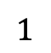
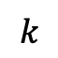
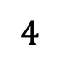
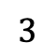
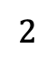
Quantum Entanglement, Decoherence, and Swapping
Establish a link-level entanglement
$$1$$
$$k$$
$$2$$
...
$$3$$
$$4$$
Quantum Switch
discard a link-level entanglement with low fidelity due to decoherence
Notes:
Quantum switch can establish link-level entanglements between itself and its connected user by sharing a pair of entangled qubits. These link-level entanglements are subject to the noise in the environment. Hence, the quality of link-level entanglements will decrease. This phenomenon is called decoherence.
For the existing link-level entanglements, the quantum switch can choose to perform a basis measurement on the qubits stored in the quantum switch and provide a user entanglement. Such an operation is called quantum swapping. Two common basis measurements are bipartite and tripartite basis measurements.

Slide 5


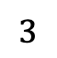
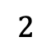
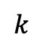
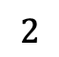
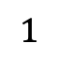
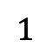
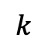
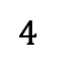
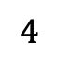
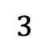
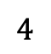
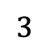
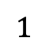
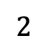
Quantum Entanglement, Decoherence, and Swapping
Bipartite basis measurement
$$k$$
$$1$$
...
$$2$$
$$3$$
$$1$$
$$4$$
$$k$$
Quantum Switch
$$2$$
...
$$3$$
$$4$$
Quantum Switch
$$k$$
$$1$$
$$2$$
...
Tripartite basis measurement
$$4$$
$$3$$
Quantum Switch
Notes:
We consider that the quantum switch can perform two basis measurements. One is the bipartite basis measurement. The successful implementation of the bipartite basis measurement can provide a bipartite user entanglement, which is represented as a Poisson process with a mean rate \mu2.
Another basis measurement is the tripartite basis measurement. Note that it is more difficult to successfully perform a tripartite basis measurement than a bipartite basis measurement. We assume the mean rate \mu_3 is smaller than \mu_2.

Slide 6
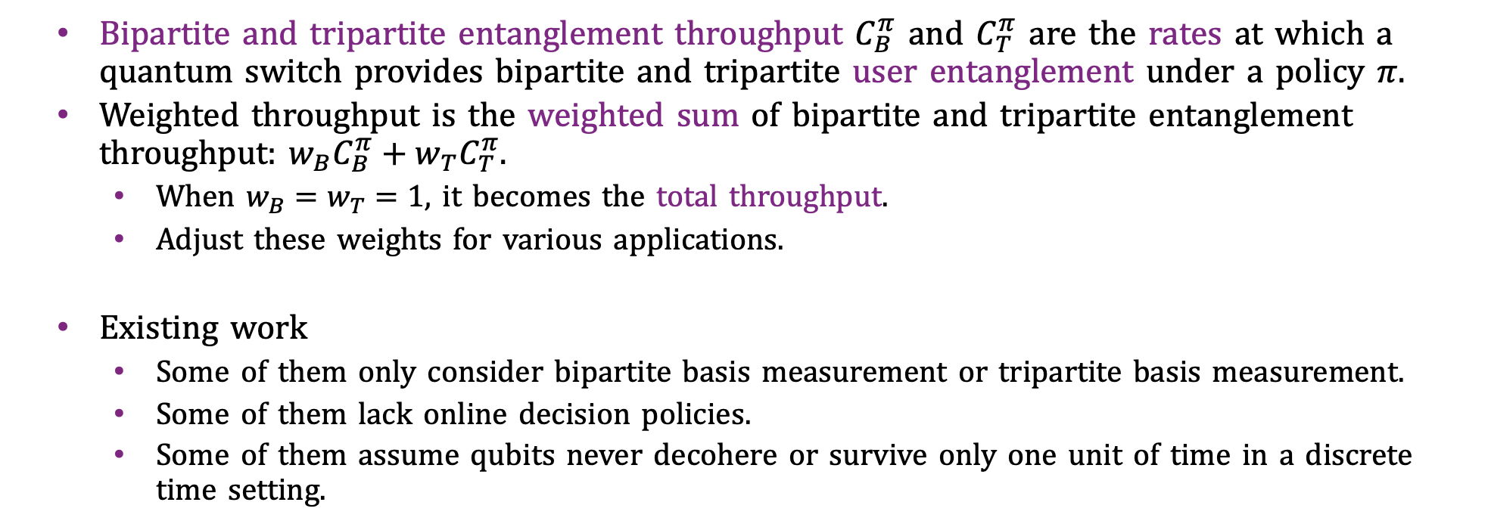
Weighted Throughput
Bipartite and tripartite entanglement throughput $C_{B}^{π}$ and $C_{T}^{π}$ are the rates at which a quantum switch provides bipartite and tripartite user entanglement under a policy $π$.
Weighted throughput is the weighted sum of bipartite and tripartite entanglement throughput: $w_{B}C_{B}^{π}+w_{T}C_{T}^{π}$.
When $w_{B}=w_{T}=1$, it becomes the total throughput.
Adjust these weights for various applications.
Existing work
Some of them only consider bipartite basis measurement or tripartite basis measurement.
Some of them lack online decision policies.
Some of them assume qubits never decohere or survive only one unit of time in a discrete time setting.
Find optimal online entanglement policies that can maximize the weighted throughput, when link-level entanglement decoherence exists in a continuous-time setting!
Notes:
We define the bipartite or tripartite entanglement throughput as the rate at which a quantum switch provides bipartite or tripartite user entanglement under a given policy \pi.
We define the weighted throughput as the weighted sum of bipartite and tripartite entanglement throughput. When the weights are 1, it becomes the total throughput, which measures the total capacity of a quantum switch for providing user entanglements. One can adjust these weights to reflect the relative importance of bipartite and tripartite user entanglements for various applications.
Due to the importance of the quantum switch, researchers have made efforts to study its performance. However, they either only consider one type of user entanglement or lack online decision polices. Even though some work proposed online decision policies, they assume qubits never decohere or survive only one unit of time in a discrete time setting. These assumptions will lead to inaccurate estimations of the performance of a quantum switch.
Thus, one problem that has not been solved yet is whether one can find optimal online entanglement policies that can maximize the weighted throughput, when link-level entanglement decoherence exists in a continuous-time setting!

Slide 7
Contributions
Propose to use the relative value iteration algorithm to obtain the optimal policy under the Markov decision process (MDP) formulation.
Discover the threshold-based property between entanglement policies
Bipartite policy vs. Tripartite policy
Bipartite/Tripartite policy vs. Mixed policy
With or without decoherence
Uncover the threshold-based structural property of the optimal policy
With or without decoherence
Notes:
In our work, we propose to use the relative value iteration algorithm to obtain the optimal policy under our MDP formulation. Further, we theoretically and empirically discover a threshold-based property between entanglement policies. This motivates us to explore the threshold-based structure of optimal policy.

Slide 8
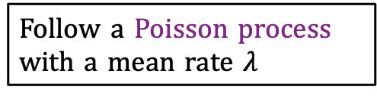
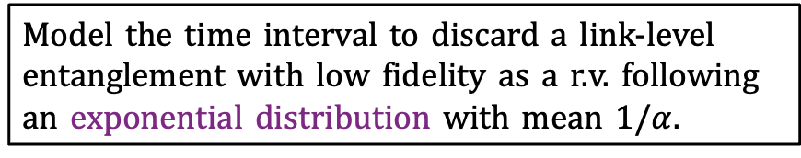
Dynamics of a Quantum Switch
Follow a Poisson process with a mean rate $λ$
We assume the links are homogeneous and statistically independent.
$$1$$
$$k$$
$$2$$
...
We assume each link only has one buffer.
$$3$$
$$4$$
Quantum Switch
Model the time interval to discard a link-level entanglement with low fidelity as a r.v. following an exponential distribution with mean $1/α$.
Notes:
We now provide a model description of the quantum switch, especially its real-world dynamics.
First, the quantum switch can establish link-level entanglement between itself and the connected users. We assume the arrival process of successful establishment of LLEs on a channel is represented as a Poisson process with a mean rate \lambda.
Besides, we assume the links are homogeneous and statistically independent in the sense that the arrival rates on each link are the same.
As time goes by, there will be more and more link-level entanglements that appear.
We also assume each link only has one buffer, indicating that there is at most one link-level entanglement on each link that can be stored.
Since the qubits are subject to environmental noise, they may undergo decoherence. We model the time interval to discard a link-level entanglement with low fidelity as a random variable following an exponential distribution with mean $1/α$.

Slide 9
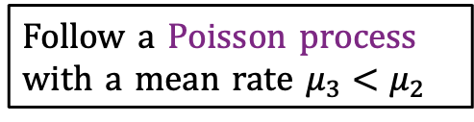
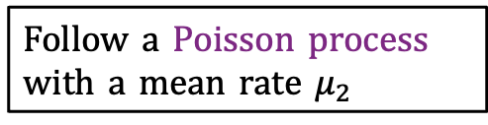
Dynamics of a Quantum Switch
Follow a Poisson process with a mean rate $μ_{2}$
Bipartite basis measurement
$$k$$
$$1$$
...
$$2$$
$$3$$
$$4$$
$$1$$
Quantum Switch
$$k$$
$$2$$
...
$$3$$
$$4$$
Quantum Switch
$$k$$
$$1$$
$$2$$
...
Tripartite basis measurement
$$4$$
$$3$$
Follow a Poisson process with a mean rate $μ_{3}<μ_{2}$
Quantum Switch
Notes:
We consider that the quantum switch can perform two basis measurements. One is the bipartite basis measurement. The successful implementation of the bipartite basis measurement can provide a bipartite user entanglement, which is represented as a Poisson process with a mean rate \mu2.
Another basis measurement is the tripartite basis measurement. Note that it is more difficult to successfully perform a tripartite basis measurement than a bipartite basis measurement. We assume the mean rate \mu_3 is smaller than \mu_2.

Slide 10

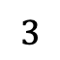
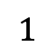
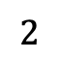
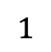
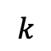
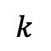
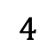
Dilemma of a Quantum Switch
Bipartite basis measurement
$$k$$
$$1$$
...
$$2$$
$$3$$
$$4$$
$$1$$
Quantum Switch
$$k$$
$$2$$
...
$$3$$
$$4$$
Quantum Switch
$$k$$
$$1$$
$$2$$
...
Tripartite basis measurement
$$4$$
$$3$$
Pro: induces higher throughput
Con: incurs delay due to the waiting and decoherence
Quantum Switch
Notes:
Now, let's consider such a scenario. Suppose that there are two existing link-level entanglements.
The quantum switch can directly perform the bipartite basis measurement because there are sufficient link-level entanglements already.
The quantum switch can also choose to wait for another arrival of link-level entanglement and then perform the tripartite basis measurement.
Even though the second method can induce higher throughput by performing tripartite basis measurement, this could also incur a delay because you need to wait for the new link-level entanglement. Besides, the probability of successfully performing a tripartite basis measurement is smaller than that of performing a bipartite basis measurement. This may further extend the waiting time. During the waiting time, we may lose the existing link-level entanglement due to decoherence.
Therefore, it poses a question about what the quantum switch should do in this case.

Slide 11
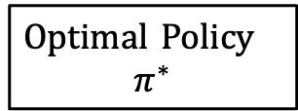
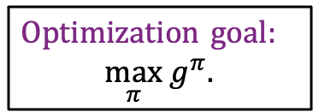
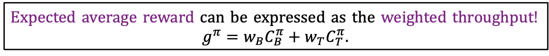
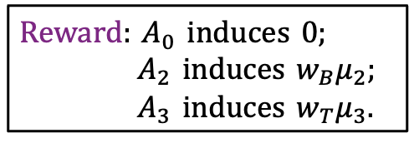
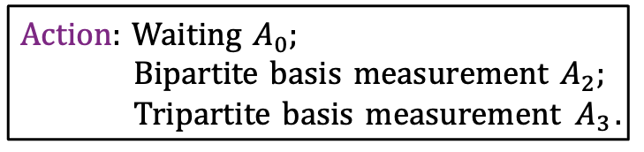
Markov Decision Process (MDP) Formulation
State: number of existing link-level entanglement
Action: Waiting $A_{0}$;
Bipartite basis measurement $A_{2}$;
Tripartite basis measurement $A_{3}$.
Reward: $A_{0}$ induces 0;
$A_{2}$ induces $w_{B}μ_{2}$;
$A_{3}$ induces $w_{T}μ_{3}$.
$$1$$
$$k$$
$$2$$
...
Transition probability matrix: follow the dynamics of the quantum switch.
$$3$$
$$4$$
Quantum Switch
Expected average reward can be expressed as the weighted throughput!
$g^{π}=w_{B}C_{B}^{π}+w_{T}C_{T}^{π}$.
Optimization goal:
${\max_{π} g}^{π}$.
Relative value iteration algorithm
Optimal Policy
$$π^{∗}$$
Notes:
To find the right decision between bipartite and tripartite basis measurements in maximizing the weighted throughput, we use the theory of MDP to model the dynamics of the quantum switch.
We define the state as the number of existing link-level entanglements and consider three actions. The transition probability matrix is defined by the previous dynamics of the quantum switch.
By suitably choosing the reward for each action, the expected average reward can be expressed as the weighted throughput. Then, our optimization goal becomes to find a policy \pi that maximizes the expected average reward. For this optimization goal, we can obtain the optimal policy by using the relative value iteration algorithm

Slide 12
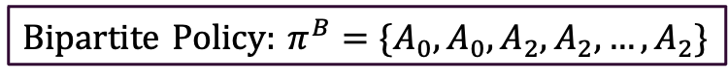
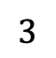
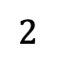
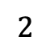
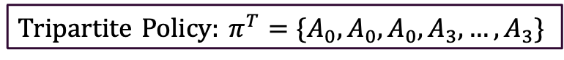
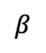
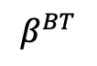
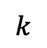
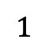
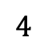
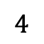
Bipartite Policy vs. Tripartite Policy
Consider $w_{B}=η^{β}$ and $w_{T}={\left(η+Δ\right)}^{β}$, where $η∈(1,+∞)$ and $Δ∈\left(0,+∞\right).$
$w_{B}>w_{T}$ when $β<0;$ $w_{B}<w_{T}$ when $β>0.$
Holds for both cases where decoherence exists or not!
$$k$$
$$1$$
$$k$$
$$1$$
$$2$$
$$2$$
<
...
>
...
$$3$$
$$4$$
$$4$$
$$3$$
Quantum Switch
Quantum Switch
Bipartite Policy: $π^{B}=\{A_{0}, A_{0}, A_{2},A_{2},…,A_{2}\}$
Tripartite Policy: $π^{T}=\{A_{0}, A_{0}, A_{0},A_{3},…,A_{3}\}$
$$β^{BT}$$
$$β$$
Notes:
Under the MDP framework, we theoretically reveal a threshold-based relationship between a bipartite policy and a tripartite policy, two extreme cases in the policy space.
In order to analyze how varying the emphasis on bipartite and tripartite user entanglement affects the weighted throughput, we consider the weights to be a family of weight functions with a parameter \beta.
By adjusting the values of \beta, we can model the cases when w_B is larger or smaller than w_T.
Specifically, the bipartite policy will induce a higher weighted throughput than the tripartite policy when \beta is smaller than a threshold \beta^BT. When \beta exceeds the threshold \beta^BT, the tripartite policy will induce a higher weighted throughput than the bipartite policy.
Note that this threshold-based relationship holds for both cases where decoherence exists or not.

Slide 13
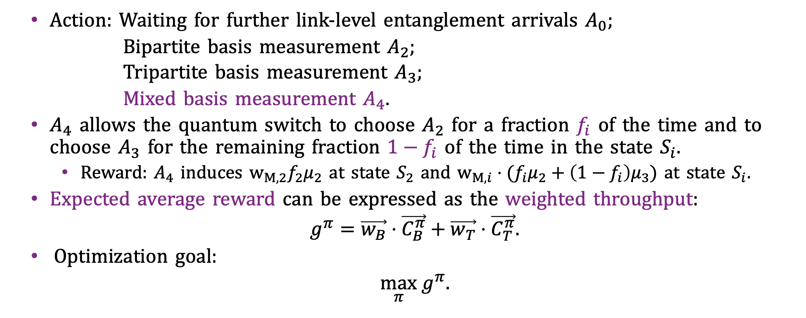
A New Mixed Action
Action: Waiting for further link-level entanglement arrivals $A_{0};$
Bipartite basis measurement $A_{2}$;
Tripartite basis measurement $A_{3}$;
Mixed basis measurement $A_{4}$.
$A_{4}$ allows the quantum switch to choose $A_{2}$ for a fraction $f_{i}$ of the time and to choose $A_{3}$ for the remaining fraction $1−f_{i}$ of the time in the state $S_{i}.$
Reward: $A_{4}$ induces $w_{M,2}f_{2}μ_{2}$ at state $S_{2}$ and $w_{M,i}⋅(f_{i}μ_{2}+\left(1−f_{i}\right)μ_{3})$ at state $S_{i}$.
Expected average reward can be expressed as the weighted throughput:
$g^{π}=\vec{w_{B}}⋅\vec{C_{B}^{π}}+\vec{w_{T}}⋅\vec{C_{T}^{π}}$.
Optimization goal:
${\max_{π} g}^{π}$.
State-dependent
Notes:
We further extend our analysis to include a new mixed action A_4. This mixed action allows the quantum switch to choose $A_{2}$ for a fraction $f_{i}$ of the time and to choose $A_{3}$ for the remaining fraction $1−f_{i}$ of the time in the state $S_{i}.$ Note that the fraction f_i and (1-f_i) depend on state.
Therefore, the mixed action will induce a state-dependent reward.
After including this new action, the expected average reward can still be expressed as the weighted throughput, but in a generalized inner product form. Our optimization goal remains the same.

Slide 14
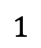
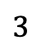












Bipartite Policy vs. Mixed Policy
Consider $w_{B}=η^{β}$ and $w_{M,i}={\left(f_{i}η+(1−f_{i})(η+Δ)\right)}^{β}$ for $2≤i≤k$ , where $η∈(1,+∞)$ and $Δ∈\left(0,+∞\right).$
Holds for both cases where decoherence exists or not!
$$k$$
$$1$$
$$2$$
<
$$k$$
$$k$$
$$1$$
...
>
$$1$$
$$2$$
$$3$$
$$f_{i}$$
...
$$2$$
$$+(1−f_{i})$$
...
$$4$$
$$4$$
$$3$$
$$4$$
$$3$$
Quantum Switch
Bipartite Policy: $π^{B}=\{A_{0}, A_{0}, A_{2},A_{2},…,A_{2}\}$
Mixed Policy: $π^{M}=\{A_{0}, A_{0}, A_{4},A_{4},…,A_{4}\}$
$$β^{BM}(\vec{f})$$
$$β$$
Notes:
We also compare the bipartite policy with the mixed policy. We found that under certain constraints, the bipartite policy will induce higher weighted throughput than the mixed policy, when \beta is smaller than the threshold \beta^BM. When the \beta exceeds the threshold, the mixed policy will induce higher weighted throughput than the bipartite policy.

Slide 15





Tripartite Policy vs. Mixed Policy
Consider $w_{T}={(η+Δ)}^{β}$ and $w_{M,i}={\left(f_{i}η+(1−f_{i})(η+Δ)\right)}^{β}$ for $2≤i≤k$ , where $η∈(1,+∞)$ and $Δ∈\left(0,+∞\right).$
Holds for both cases where decoherence exists or not!
$$k$$
$$1$$
$$2$$
<
...
$$k$$
>
$$k$$
$$1$$
$$1$$
$$2$$
$$2$$
$$+(1−f_{i})$$
$$4$$
$$3$$
$$f_{i}$$
...
...
$$4$$
$$4$$
$$3$$
Quantum Switch
$$3$$
Mixed Policy: $π^{M}=\{A_{0}, A_{0}, A_{4},A_{4},…,A_{4}\}$
Tripartite Policy: $π^{T}=\{A_{0}, A_{0}, A_{0},A_{3},…,A_{3}\}$
$$β^{MT}(\vec{f})$$
$$β$$
Notes:
P15: We further compare the tripartite policy with the mixed policy. We found that, when \beta is smaller than a threshold \beta^{MT}, the mixed policy can induce a higher weighted throughput than the tripartite policy. When \beta is larger than the threshold, the tripartite policy can induce a higher weighted throughput than the mixed policy.

Slide 16

Existence of Thresholds between Bipartite, Tripartite and Mixed Policies
These figures show the existence of $β^{BT}$.
(a) Without decoherence
(b) With decoherence
Notes:
We perform numerical experiments to confirm our theoretical analysis on the threshold-based relationship between the entanglement policies.
These two figures show that, when decoherence exists or not, the threshold \beta^BT always exists.
The decoherence only affects the value of the threshold and makes the weighted throughput decrease.

Slide 17

Existence of Thresholds between Bipartite, Tripartite and Mixed Policies
These figures show the existence of $β^{BM}$.
(a) Without decoherence
(b) With decoherence
Notes:
These two figures are used to show that the threshold \beta^{BM} between bipartite and mixed policy indeed exists, no matter decoherence exists or not.

Slide 18

Existence of Thresholds between Bipartite, Tripartite and Mixed Policies
These figures show the existence of $β^{MT}$.
(a) Without decoherence
(b) With decoherence
Notes:
Similarly, we can empirically reveal the threshold \beta^{MT} when decoherence exists or not.

Slide 19
Existence of a Threshold-based Optimal Policy
The optimal policy changes from the bipartite policy to the tripartite policy as $β$ increases.
Purely bipartite region
State: the number of existing link-level entanglements
Bipartite policy
Purely tripartite region
State-dependent transition
Without decoherence
Tripartite policy
Notes:
The previous threshold-based relationship between the entanglement policies motivates us to explore the structure of the optimal policy. We found that the optimal policy changes from the bipartite policy to the tripartite policy as the weight parameter \beta increases.
We summarize the results when decoherence does not exist in this table.
Here, S0 to S8 denote the number of existing link-level entanglements between the quantum switch and users. In the green area, it shows that when \beta lies in this range, the optimal policy is the bipartite policy. We define such a range of \beta as the purely bipartite region.
In the red area, it shows that when \beta lies in this range, the optimal policy is the tripartite policy. We define this range of \beta as the purely tripartite region.
Such a transition from a bipartite policy to a tripartite policy is achieved by the state-dependent transition of optimal action. For example, the optimal action for state 3 is bipartite basis measurement initially, which becomes tripartite basis measurement as \beta increases.

Slide 20
Existence of a Threshold-based Optimal Policy
The optimal policy changes from the bipartite policy to the tripartite policy as $β$ increases.
Purely bipartite region
Purely tripartite region
State-dependent transition
With decoherence
Notes:
A Similar threshold-based structure also exists when decoherence exists. We can still observe the existence of the purely bipartite and tripartite regions.

Slide 21
Existence of a Threshold-based Optimal Policy with the Mixed Action
The optimal policy changes from the bipartite policy to the tripartite policy as $β$ increases.
Purely bipartite region
State: the number of existing link-level entanglements
Bipartite policy
Purely tripartite region
State-dependent transition
Without decoherence
Tripartite policy
Notes:
We also reveal the threshold-based structure of the optimal policy when the mixed action is included. In this table, we can observe the existence of purely bipartite region and purely tripartite region. What is different from the previous case is the state-dependent transition. For example, the optimal action of state 6 is the bipartite basis measurement initially, which becomes the mixed basis measurement and the tripartite basis measurement in the end.

Slide 22
Existence of a Threshold-based Optimal Policy with the Mixed Action
The optimal policy changes from the bipartite policy to the tripartite policy as $β$ increases.
Purely bipartite region
Purely tripartite region
State-dependent transition
With decoherence
Notes:
A similar structure also holds when decoherence exists.

Slide 23
Conclusion
Threshold-based relationship between entanglement policies
Bipartite policy vs. tripartite policy
Bipartite/Tripartite policy vs. mixed policy
Threshold-based structure of optimal entanglement policy
Existence of purely bipartite region and purely tripartite region
Robust to the decoherence effect
Reduce the search space of the optimal policy
Notes:
We conclude our work with following points
First, we both theoretically and empirically reveal the threshold-based relationship between entanglement policies. These threshold-based relationships motivate us to explore the threshold-based structure of optimal entanglement policy
We show the threshold-based structure of optimal policy by showing the existence of purely bipartite region and purely tripartite region. Such a threshold-based structure is robust to the decoherence effect and significantly reduces the search space of the optimal policy under different relative importance between bipartite and tripartite user entanglement.

Slide 24
Thank you for listening!
Q&A
If you want more discussion, feel free to reach me at
https://robinbinluo.github.io/ or binluo@link.cuhk.edu.hk
Notes:
Thanks for listening. Feel free to reach out to me for further discussions. Now I’m happy to answer questions.

Slide 25











Quantum Entanglement, Decoherence, and Swapping
The quantum switch can establish link-level entanglements between itself and its connected users.
The fidelity of link-level entanglements may decrease over time due to decoherence.
Perform a bipartite or tripartite basis measurement to generate a bipartite or tripartite (end-to-end) user entanglement.
Tripartite Basis Measurement
$$1$$
Bipartite Basis Measurement
$$1$$
$$1$$
$$k$$
$$1$$
$$k$$
$$k$$
$$1$$
$$k$$
$$k$$
$$2$$
$$2$$
$$2$$
$$2$$
$$2$$
...
...
...
...
...
$$3$$
$$3$$
$$3$$
$$3$$
$$4$$
$$4$$
$$3$$
$$4$$
$$4$$
$$4$$
Quantum Switch
Quantum Switch
Quantum Switch
Quantum Switch
Quantum Switch
Notes:
Quantum switch can establish link-level entanglements between itself and its connected user by sharing a pair of entangled qubits. These link-level entanglements are subject to the noise in the environment. Hence, the quality of link-level entanglements will decrease. This phenomenon is called decoherence.
For the existing link-level entanglements, the quantum switch can choose to perform a basis measurement on the qubits stored in the quantum switch and provide a user entanglement. Such an operation is called quantum swapping. Two common basis measurements are bipartite and tripartite basis measurements.

Slide 26

Markov Decision Process (MDP) Formulation
State: the number of existing link-level entanglements
Action: Waiting for further link-level entanglement arrivals $A_{0};$
Bipartite basis measurement $A_{2}$;
Tripartite basis measurement $A_{3}$
Transition probability matrix: follow the dynamics of the quantum switch.
Reward: $A_{0}$ induces 0; $A_{2}$ induces $w_{B}μ_{2}$; $A_{3}$ induces $w_{T}μ_{3}$.
Expected average reward can be expressed as the weighted throughput:
$g^{π}=w_{B}C_{B}^{π}+w_{T}C_{T}^{π}$.
Optimization goal:
${\max_{π} g}^{π}$.
Notes:
To find the right decision between bipartite and tripartite basis measurements in maximizing the weighted throughput, we use the theory of MDP to model the dynamics of the quantum switch.
We define the state as the number of existing link-level entanglements and consider three actions. The transition probability matrix is defined by the previous dynamics of the quantum switch.
By suitably choosing the reward for each action, the expected average reward can be expressed as the weighted throughput. Then, our optimization goal becomes to find a policy \pi that maximizes the expected average reward. For this optimization goal, we can obtain the optimal policy by using the relative value iteration algorithm

Slide 27






Bipartite Policy vs. Mixed Policy
Consider $w_{B}=η^{β}$ and $w_{M,i}={\left(f_{i}η+(1−f_{i})(η+Δ)\right)}^{β}$ for $2≤i≤k$ , where $η∈(1,+∞)$ and $Δ∈\left(0,+∞\right).$
$$k$$
$$1$$
$$β^{BM}(\vec{f})$$
$$k$$
$$k$$
$$1$$
...
$$2$$
$$1$$
$$2$$
$$3$$
$$β$$
$$f_{i}$$
...
$$2$$
$$+(1−f_{i})$$
...
$$4$$
$$4$$
$$3$$
$$4$$
$$3$$
Quantum Switch
Bipartite Policy: $π^{B}=\{A_{0}, A_{0}, A_{2},A_{2},…,A_{2}\}$
Mixed Policy: $π^{M}=\{A_{0}, A_{0}, A_{4},A_{4},…,A_{4}\}$
Holds for both cases where decoherence exists or not!
Notes:
We also consider the state-dependent weights of the mixed action to be an exponential function. WE found that under certain constraints, the bipartite policy will induce higher weighted throughput than the mixed policy, when \beta is smaller than the threshold \beta^BM. When the \beta exceeds the threshold, the mixed policy will induce higher weighted throughput than the bipartite policy.

Slide 28




Tripartite Policy vs. Mixed Policy
Consider $w_{T}={(η+Δ)}^{β}$ and $w_{M,i}={\left(f_{i}η+(1−f_{i})(η+Δ)\right)}^{β}$ for $2≤i≤k$ , where $η∈(1,+∞)$ and $Δ∈\left(0,+∞\right).$
$$k$$
$$1$$
$$2$$
$$β^{MT}(\vec{f})$$
...
$$k$$
$$k$$
$$1$$
$$2$$
$$1$$
$$β$$
$$f_{i}$$
...
$$2$$
$$+(1−f_{i})$$
...
$$4$$
$$4$$
$$4$$
$$3$$
$$3$$
$$3$$
Quantum Switch
Mixed Policy: $π^{M}=\{A_{0}, A_{0}, A_{4},A_{4},…,A_{4}\}$
Tripartite Policy: $π^{T}=\{A_{0}, A_{0}, A_{0},A_{3},…,A_{3}\}$
Holds for both cases where decoherence exists or not!
Notes:
Similarly, when \beta is smaller than a threshold \beta^{MT}, the mixed policy can induce a higher weighted throughput than the tripartite policy. When \beta is larger than the threshold, the tripartite policy can induce a higher weighted throughput than the mixed policy.

Slide 29
Existence of a Threshold-based Optimal Policy with the Mixed Action
The optimal policy changes from the bipartite policy to the tripartite policy as $β$ increases.
Purely bipartite region
(b) With decoherence
Purely tripartite region
Notes:
We further explore the optimal entanglement policies of the quantum switch when the mixed action is included.
We also observe that the purely bipartite region and purely tripartite region exist whether decoherence exists or not. That is to say, the optimal policy changes from the bipartite policy to the tripartite policy as \beta increases.
Even for the range of $\beta$ where neither bipartite policy nor tripartite policy is optimal, there is a tendency for the optimal entanglement action of a given state $S_j$ to shift from bipartite action to mixed action and finally tripartite action as $\beta$ increases. For example, on the LHS, the optimal action for state 6 is action 2 initially and becomes action 4 and finally becomes action 3, as the \beta increases.

Slide 30
Existence of a Threshold-based Optimal Policy with the Mixed Action
The optimal policy changes from the bipartite policy to the tripartite policy as $β$ increases.
Purely bipartite region
(a) Without decoherence
(b) With decoherence
Purely tripartite region
Notes:
We further explore the optimal entanglement policies of the quantum switch when the mixed action is included.
We also observe that the purely bipartite region and purely tripartite region exist whether decoherence exists or not. That is to say, the optimal policy changes from the bipartite policy to the tripartite policy as \beta increases.
Even for the range of $\beta$ where neither bipartite policy nor tripartite policy is optimal, there is a tendency for the optimal entanglement action of a given state $S_j$ to shift from bipartite action to mixed action and finally tripartite action as $\beta$ increases. For example, on the LHS, the optimal action for state 6 is action 2 initially and becomes action 4 and finally becomes action 3, as the \beta increases.

